Slide 1
Product Management
in the Artificial Intelligence Era
© 2020 Adnan Boz. All rights reserved.

Slide 2
Classroom ethics
2
Please have your name on the screen
Please keep your mic muted during the class
Please raise your hand to ask a question
Please turn on your video if possible

Slide 3
Course Prerequisities
3
Having Product Management training or experience
© 2020 Adnan Boz. All rights reserved.

Slide 4
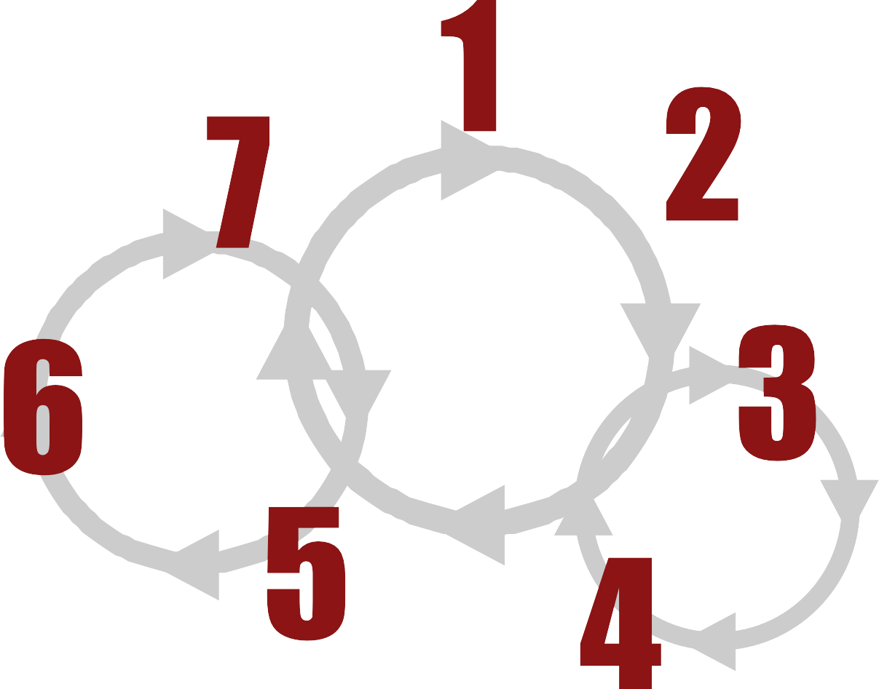
4
Design Sprint
Business, Requirement & Data Analysis
Evaluate & Experiment
Agile AI
Product
[Development]
Lifecycle
Release
AI Solution Research
Build
Rapid Experimentation

Slide 5
Annual Salaries of AI Related Roles
5
$
$100K
$200K
$300K $400K
$500K
Chief AI Officer
SVP of AI Products
VP of AI Prod
ucts
Dire
ctor AI PM
AI
PM
AI Architect
Data Scientist
So
ftware Engineer

Slide 6

Choose a problem
6
Marketing
Retargeting Recommendation Pricing optimization Social media marketing Omnichannel
Visual search
Customer Service
Call analytics
Sales
Lead generation Sales forecasting Sales call analytics Prescriptive sales Retail sales bot Sales attribution
Call intent discovery Voice authentication Call classification Customer service Chatbot
Analytics
Data preparation Data Transformation Conversational Analyt. Real-Time Analytics
Data Visualization
Sound analytics
Manufacturing
RPA
Predictive maintenance Manufacturing Analytics Supply chain optimiza.
Collaborative Robot
Robotics
IT
Anomaly detection
Secure communications Developer assistance Deception security Cybersecurity
AI developer
FinTech
Fraud Detection Financial Analytics Expense reporting Credit Scoring Robo-Advisory Insurance
HealthTech
Patient analytics
Personal medication Early diagnosis Medical imaging Drug discovery Gene analytics
Automotive
Self driving cars Fleet management Vehicle cybersecurity Mapping systems Driving assistant Vision systems

Slide 7
Common Cloud AI Solution Layers
7
Robotics
Neuroscien ce
Space Science
Materials science
...
AI Industries
CV
MT
NLP
ASR
...
Responsible AI
AI Applications
Security
Productivity Tools
FW & Algorithms
AutoML
Distributed Systems
...
AI Platform
Super computers
AI
Accelerator
Storage
Network
...
AI Infrastructure

Slide 8
AI for Product Managers

Slide 9
Enterprise SW/HW 101
9
Common Application | Engineering Application | User Application | SW Engineering | Incident Management | Change Management
Web browser, Terminal, File | IDE, Compilers, ML | Content management,
browser, Anti-virus, | Frameworks, Jupyter | Content curation,
Communication tools | notebooks, Version control, | Productivity tools
 | CI/CD
 | Distributed System Software
 | Storage, Compute, Memory
Management Software |  |  | IT Operations
Server management, Network management, Storage management, Security
System Software
Operating systems, Device drivers, File systems
Virtualization Software
Compute, Network, Memory, Storage
Hardware
Compute, NIC, Memory, Storage, Accelerators, IoT, Embedded, Mobile

Slide 10
On-prem Content Recommendation System
10
High Throughput Content Web Service
User
Data Flow
Feature Extractor Services
NLP
Real-time AI Model Re-training Pipeline
AI
Context Features
Fast Feature Index
Product Recommen dation
Content Sources
Real-time Content
Processing Pipeline
Activity Logs
Human
Judgeme nt
Content Features
Near-real-time Event Analysis Pipeline
Real-time Feature Indexing Pipeline
Event Store
Near-real-time User Profile Pipeline
User Features
User Events

Slide 11
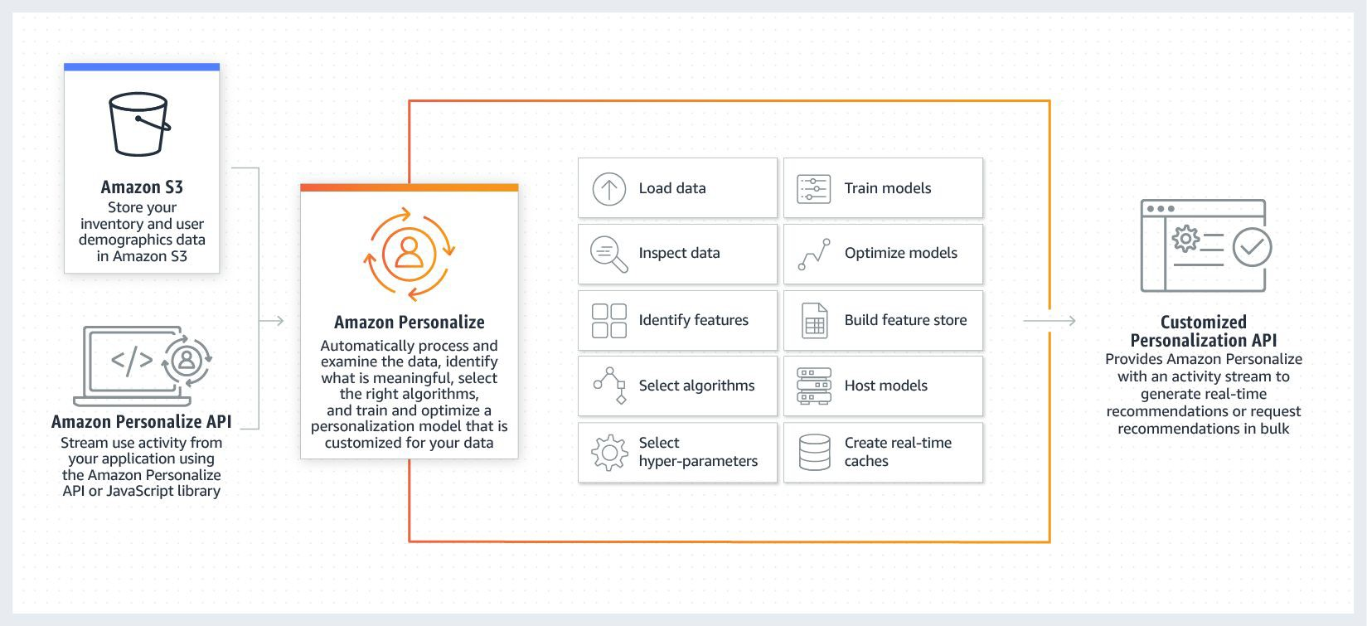
Software Architecture (SaaS Alternative 1)
Amazon Personalize
11
Content Sources
Human
Judgeme nt
User
User Events

Slide 12
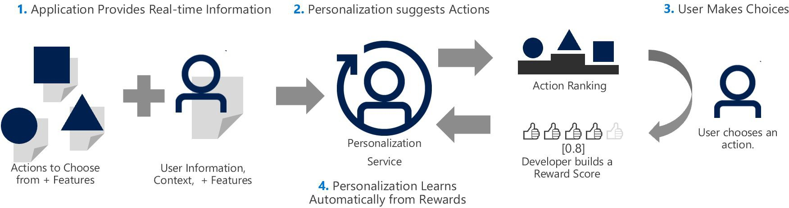
Software Architecture (SaaS Alternative 2)
Microsoft Personalize
12
Content Sources
Human
Judgeme nt
User
User Events

Slide 13

13
AI Solution
Strategy
Data
Algorithm
Framework
Platform
Infrastructure
Aspects of AI Solutions for Product Managers

Slide 14
External Data Acquisition
Name | Solution | URL
Google Dataset search | Find datasets through a simple keyword search | toolbox.google.com/datasetsearch
Wikipedia Reference | List of datasets for machine learning research | List_of_datasets_for_machine_learning_research
Amazon Mechanical Turk | Marketplace to automate simple processes | mturk.com
CrowdAI | Automate the discovery of objects at scale | crowdai.com
Figure Eight | Human-in-the-Loop machine learning platform | figure-eight.com
Lionbridge.ai | Data entry, collection, processing, labeling and validation. | lionbridge.ai
Computyne | End-to-end data entry, processing, web scraping and more | computyne.com
Diffbot | Automatically extract web pages as structured data | diffbot.com
Import.io | Extract data from almost any website | import.io
Playment.io | Training data, image annotation and more for enterprise | playment.io
BlueKai | World's largest 3rd party data marketplace | oracle.com/corporate/acquisitions/bluekai/
Qlik | Helps you find, connect and manage data from external sources | ^{qlik.com} © 2020 Adnan Boz. All rights reserved.

Slide 15
Why Use ML Frameworks?
Build ML Model
from keras.models import Sequential from keras.layers import Dense
model = Sequential()
model.add(Dense(units=64, activation='relu', input_dim=100)) model.add(Dense(units=10, activation='softmax')) model.compile(loss='categorical_crossentropy',
optimizer='sgd',
metrics=['accuracy'])
Train ML Model
model.fit(x_train, y_train, epochs=5, batch_size=32)
Make Prediction
classes = model.predict(x_test, batch_size=128)

Slide 16
ML Frameworks
16
Name | Link | Company | Contributor | Source | License | API Languages
Apache SINGA | https://singa.incubator.apache.org | Apache Incubator | 45 | https://github.com/apache/incubator-singa | Apache 2.0 | Python, C++, Java
Caffe | http://caffe.berkeleyvision.org/ | Berkeley V&LCenter | 263 | https://github.com/BVLC/caffe | BSD license | Python, MATLAB
Caffe2 | https://caffe2.ai/ | Facebook | 197 | https://github.com/caffe2/caffe2 | Apache 2.0 | C++, Python, MATLAB
CNTK | https://www.microsoft.com/en-us/cognitive-toolkit/ | Microsoft | 197 | https://github.com/Microsoft/CNTK | MIT | Python, C#, C++, BrainScript
Deeplearning4j | https://deeplearning4j.org/ |  | 12 | https://github.com/deeplearning4j/deeplearning4j | Apache 2.0 | Java, Scala, Clojure, Python (Keras), Kotlin
Dlib | http://dlib.net/ |  | 127 | https://github.com/davisking/dlib | Boost | C++, Python
Gluon | https://mxnet.apache.org/gluon |  | 6 | https://github.com/gluon-api/gluon-api | Apache 2.0
Keras | https://keras.io/ |  | 802 | https://github.com/keras-team/keras | MIT | Python, R
MatConvNet | http://www.vlfeat.org/matconvnet/ |  | 22 | https://github.com/vlfeat/matconvnet | BSD license | MATLAB, C++,
MXNet | https://mxnet.apache.org/ | ML Community | 723 | https://github.com/apache/incubator-mxnet | Apache 2.0 | C++, Python, Julia, Matlab, Js, Go, R, Scala, Perl
OpenNN | http://www.opennn.net/ | Artelnics | 11 | https://github.com/Artelnics/OpenNN | GNU LGPL | C++
PaddlePaddle | http://paddlepaddle.org/ | Baidu PaddlePaddle | 242 | https://github.com/PaddlePaddle/Paddle | Apache 2.0 | C/C++, Python
PyTorch | http://pytorch.org/ |  | 1133 | https://github.com/pytorch/pytorch | BSD license | Python
Scikit-learn | http://scikit-learn.org/stable/ |  | 1386 | https://github.com/scikit-learn/scikit-learn | BSD | Python
Sockeye | http://sockeye.readthedocs.io |  | 36 | https://github.com/awslabs/sockeye |  | Python
Spark MLib | https://spark.apache.org/mllib/ |  | 1409-Spark | https://github.com/apache/spark/tree/master/mllib | Apache 2.0 | Scala, Java, Python, and R
TensorFlow | https://www.tensorflow.org/ | Google brain | 2143 | https://github.com/tensorflow/tensorflow | Apache 2.0 | C++, Java, Python, Go
Theano | http://deeplearning.net/software/theano/ |  | 326 | https://github.com/Theano/Theano | BSD license | Python (Keras)
Torch | http://www.torch.ch | Facebook, Twitter | 131 | https://github.com/torch/torch7 | BSD license | Lua, LuaJIT, C, utility library for C++/OpenCL

Slide 17

Capability Management In Business
17
Core Capabilities
Buy vs. Rent vs. Build vs. Invest
Enabling Capabilities
Supplemental Capabilities

Slide 18
Platform and Infrastructure Capabilities
18
On-premise
Infrastructure
as a service
Platform
as a service
Software
as a service
Feature Eng.
Model Retraining
Model Building
Model Training
Model Tuning
Inference
Data Storage
ML Framework
Feature Eng.
Model Retraining
Model Building
Model Training
Model Tuning
Inference
Data Storage
ML Framework
Feature Eng.
Model Retraining
Model Building
Model Training
Model Tuning
Inference
Data Storage
ML Framework
Feature Eng.
Model Retraining
Model Building
Model Training
Model Tuning
Inference
Data Storage
ML Framework
You Manage
Service Managed
Tensorflow, Deeplearning4j, Caffe2, mxnet, Microsoft CNTK etc.
ML frameworks on AWS, GCP, Azure etc.
AWS Deep Learning AMIs, GCP App Engine, IBM Watson, Heroku or custom ML instances etc.
Machine Learning on AWS, Google Cloud AI, IBM Watson Knowledge Studio, Algorithmia etc.

Slide 19
Business Strategy

Slide 20

Strategic Change
20
Intended Strategy
Deliberate Strategy
Realized Strategy
Unrealized Strategy
Emergent Strategy
“The organization's response to environmental change, constrained by the momentum of the bureaucracy and accelerated or dampened by the leadership”
Henry Mintzberg
Management Science

Slide 21
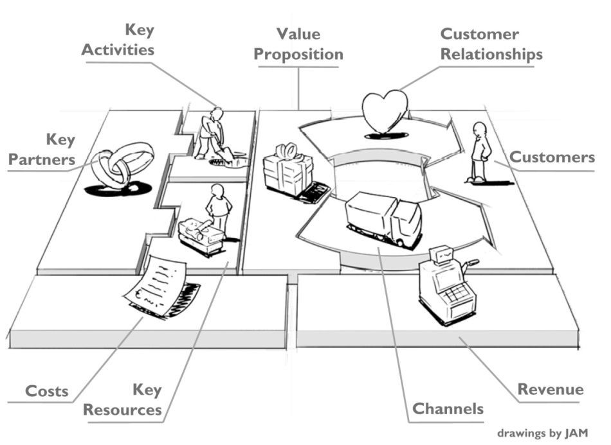

Business Analysis
21
Business Model Canvas by Alex Osterwalder
Feasibility
Desirability
Viability
https://strategyzer.com

Slide 22


Developing a Sound Strategy
Henry Mintzberg
22
Plan
Ploy
The 5 Ps of Strategy
Pattern
Perspective
Position

Slide 23
Your Company’s AI Phase
23
1990
2010
2015
2018
2020
AI Ignorant
AI Resistant
AI Aware
AI Guided
AI Driving
Hiding under a rock
Laggards
Interested
Leading their industry
Driving the AI innovation

Slide 24
Plan for Three Horizons of Growth
The Alchemy of Growth - Mehrdad Baghai and Steve Coley
24
Horizon 3 Future Business
Profit
Horizon 2 Emerging Business
ai
Innovation
Horizon 1 Core Business
ai
Adaptation & Adoption
ai
Integration
Time

Slide 25
1. C-level Executive Skills
25
AI Lifecycle and Solution Strategy
AI Industry and Domain Customers
Future Vision
Strength
Dynamics
Regulations
Corporate
(Internal)
Industry (External)
Weakness
Capabilities
Market
Economics
Tactics
Technology

Slide 26
4.,5. Skills for Data Scientist vs. Data Engineer
26
Software
Algorithms
Engineering
Machine Learning
Data Analytics
Data Scientist
Data Engineer
Data Processing
Statistics
Domain Expertise
Hacking

Slide 27
Production Team Strategies
27
Easy
Challenging
Difficult
C-level
AI Product Manager
AI Product Owner
AI Architect
Data Scientist
Data Engineer
Hiring
Training
Consulting
Outsourcing
Cognifying

Slide 28
Agile AI Product Development Lifecycle

Slide 29
29
Design Sprint
Business, Requirement & Data Analysis
Evaluate & Experiment
Agile AI
Product
[Development]
Lifecycle
Release
AI Solution Research
Build
Rapid Experimentation

Slide 30












Common Methodologies & Frameworks
30
Define
Measure
Sketch
Design
Decide
Build
Empathize
Ideate
Experiment
Map
Plan
Prototype
Test
Prototype
Learn
Learn
Review
DESIGN THINKING
LEAN STARTUP
GV DESIGN SPRINT
AGILE
Starts with empathy
Starts with an assumption
Starts with the end
Starts with the requirements

Slide 31
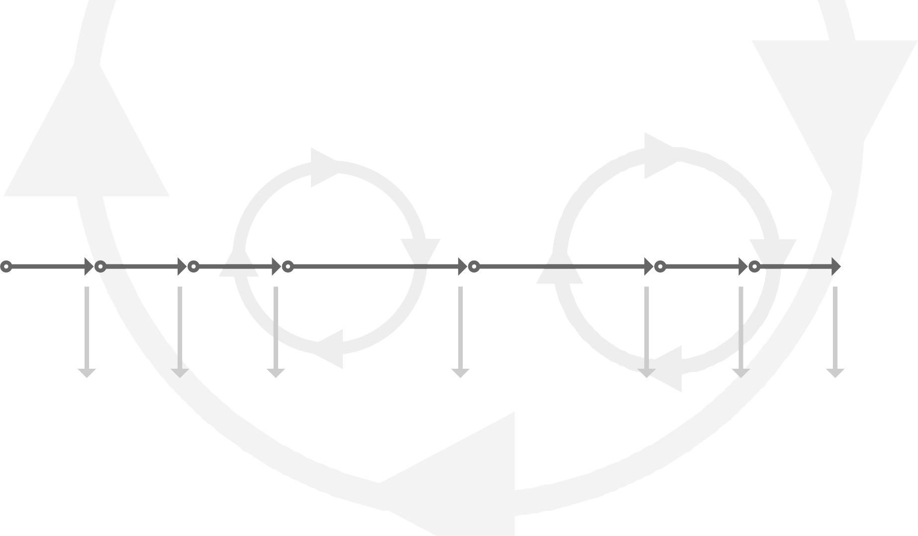
Agile AI Product Lifecycle Deliverables
31
1 | 2 | 3 | 4 | 5 | 6 | 7
Design Sprint | Requirement & Data Analysis | AI Solution Research | Rapid Experimentation | Build | Release | Evaluate & Experiment
1w | 1w | 1w | 2w | 2w | 1w | 1w
Per need basis | Quarterly | Quarterly | Continues | Continues | Daily | Weekly
Viable | Process | Solution | AI | Product / | Live | Optimization
Prototype | Model | Model | Solution | Service | Solution

Slide 32



Design Sprint 1.0 Roadmap
32
1. MAP
Map out the problem and pick an important place to focus
3. DECIDE
Make decisions and turn your ideas into a testable hypothesis
5. TEST
Test it with real live humans
MONDAY
WEDNESDAY
FRIDAY
TUESDAY
THURSDAY
2. SKETCH
Sketch competing solutions on paper
4. PROTOTYPE
Hammer out a high-ﬁdelity prototype

Slide 33
Design Sprint 2.0 Roadmap
33
1. MAP and SKETCH
3. PROTOTYPE
MONDAY
WEDNESDAY
TUESDAY
THURSDAY
2. DECIDE and STORYBOARD
4. TEST

Slide 34
Buyer Utility Map
34
Buyer Experience Cycle
 | Discover | Use App | Read News | See Ads | Subscribe
Convenience
Informative
Aesthetic Integrity
Direct Manipulation
Fun
Trust
Consistency
Utility Levers
Empathy Map Questions
Hear
See
Say
Do
Pain
Gain

Slide 35
The Four Actions Framework
35
Blue Ocean Strategy - Renée Mauborgne and W. Chan Kim
2. Reduce
Find factors which can be reduced below the industry standards
1. Eliminate
Find factors which are taken for granted in the industry
3. Create
Find factors which were never offered in the industry
Value Curve
4. Raise
Find factors which should be above the industry standards

Slide 36
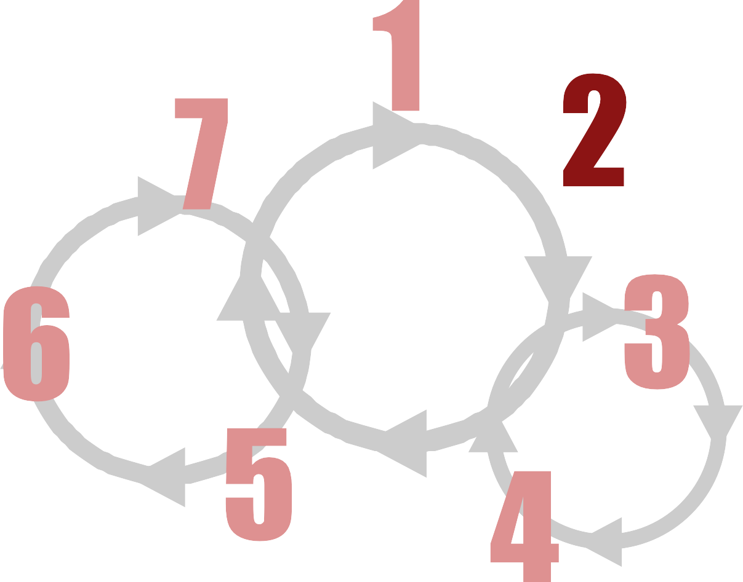
36
Design Sprint
Business, Requirement & Data Analysis
Evaluate & Experiment
Agile AI
Product
[Development]
Lifecycle
Release
AI Solution Research
Build
Rapid Experimentation

Slide 37
AI Requirement Analysis Framework
37
Standard, AI speciﬁc
Objectives
Data stories, ﬂows
Trade-offs
Orthogonalization
Error, performance
Risks
KPIs
Optimization objectives
Priorities
Quantify Metrics
See
Gather Information
Study
Understand
Structure
Organize Information

Slide 38
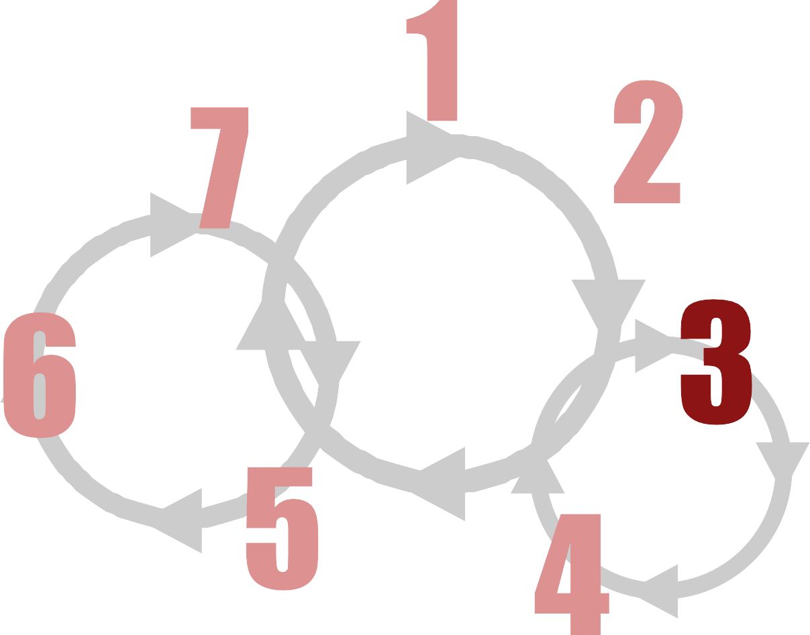
38
Design Sprint
Business, Requirement & Data Analysis
Evaluate & Experiment
Agile AI
Product
[Development]
Lifecycle
Release
AI Solution Research
Build
Rapid Experimentation

Slide 39
AI Solution Research Lifecycle
39
Set the stage
Gather solutions
Evaluate
Recommend
Goals
Storyboard
KPIs
Constraints
Research proposals
Solution proposals
Viability
Technology adoption lifecycle
Trade-offs
PM Work
DS Work
DS & PM
Work
PM Work

Slide 40
Rent vs. Buy vs. Build vs. Acquire
40
IaaS Infrastructure as a service
PaaS
Platform as a service
3rd Party Partners
SaaS
Software as a service
On-Premises
NVIDIA
Tensorflow Deeplearning4j Caffe2
Mxnet Microsoft CNTK
...
NVIDIA
Google GCP Amazon AWS Microsoft Azure IBM Cloud Alibaba Cloud Oracle Cloud
...
AWS DL AMIs
GCP App Engine IBM Watson Microsoft Azure Heroku
...
Accenture Ernst & Young McKinsey & Company IBM
...
Google Cloud AI ML on AWS
IBM Watson Microsoft Azure DataRobot Algorithmia
...

Slide 41

Evaluating SaaS Platforms
41
Sample Image
AWS
Human (99%)
People (99%)
Person (99%)
Animal (59%)
Flora (51%)
Grass (51%)
Plant (51%)
Countryside (51%)
Hill (51%)
Nature (51%)
Outdoors (51%)
GCP
Grassland (94%)
Mammal (92%)
Vertebrate (90%)
Grass (86%)
Obedience Training (77%)
Obedience Trial (76%)
Field (74%)
Lawn (72%)
Dog Walking (71%)
Meadow (71%)
Dog Like Mammal (67%) Pasture (60%)
Plant (57%)
Walking (57%)
Lure Coursing (56%)
Ecoregion (55%)
Fun (54%)
Grass Family (52%)
Landscape (51%)
Clarifyai
grass (97%)
golf (97%)
dog (97%)
landscape (97%)
mammal (94%)
competition (94%)
recreation (94%)
leisure (93%)
adult (92%)
outdoors (91%)
golfer (90%)
hayfield (90%)
ball (90%)
lawn (90%)
fun (89%)
people (89%)
one (86%)
canine (86%)
portrait (86%)
park (84%)
Azure
grass (99%)
sky (99%)
outdoor (99%)
dog (99%)
field (90%)
sport (74%) game
small holding man woman green standing little frisbee park wearing walking red playing

Slide 42
Need for AI HW Accelerators
42
CPU
Central Processing Unit
GPU
Graphics Processing Unit
FPGA
Field-programmable Gate Array
ASIC
Application Specific Integrated Circuits
Intel
AMD
Qualcomm
Apple
Samsung
NVIDIA
NVIDIA
AMD
Intel
Asus
Intel
Xilinx
Microsoft NPU
Baidu XPU
Altera
Google TPU
Intel NNP-I
Texas Instruments
Infineon
STMicroelectronics
Qualcomm
General Purpose
Specialized

Slide 43
CapEx and OpEx Cheat Sheet
43
CapEx depreciation/amortization formula: (remaining years) / (sum of all years) * (cost - salvage value) Example - 1st year of a 5 year capex: 5 / (5+4+3+2+1) * ($60000 - 0) = $20000
Depreciation for tangible assets, amortization for intangible assets. CapEx cost structure:
Fixed cost: Labor, hardware, software, manufacturing overhead
Variable cost: Materials, depreciation/amortization, production supplies
OpEx cost structure:
Fixed costs: Administrative overhead
Variable costs: Rents, staff wages, bonuses, payroll taxes, travel

Slide 44
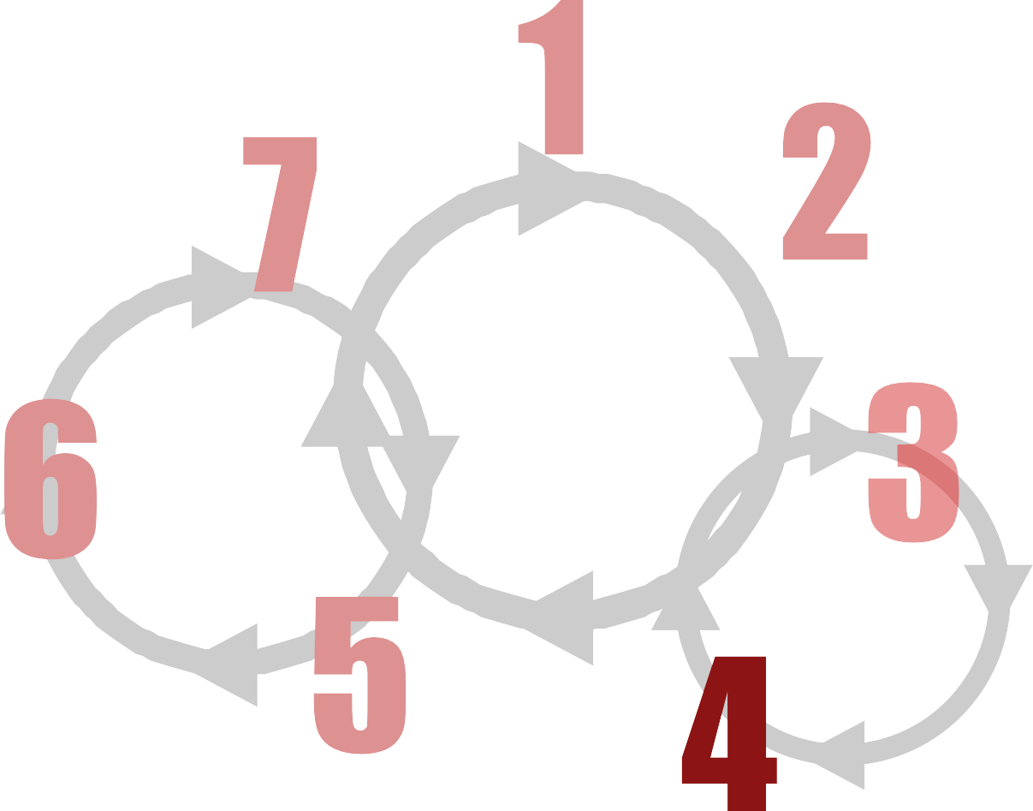
44
Design Sprint
Business, Requirement & Data Analysis
Evaluate & Experiment
Agile AI
Product
[Development]
Lifecycle
Release
AI Solution Research
Build
Rapid Experimentation

Slide 45




Rapid ML Experimentation Lifecycle (REL)
45
ETL
Build
1
2
Rapid Experimentation Lifecycle
4
3
Evaluate
Train

Slide 46
⁴⁶Rapid ML Experimentation Example (Supervised)
ETL
Find Data
Extract Data
Transform Data
Load Data
Analyze Features
Fix Data Types
Drop Features
Analyze Distribution
Descriptive Statistics
Fix NaN / Empty
Clip Outliers
Analyze Correlation
Build
Drop Features
Feature Correlation
Extract Features
Normalize
One Hot Encode
Under / Over Sample
Train
Synthesis Data
Train Algorithms
Algorithm Selection
Hyper- parameter Search
Confusion Matrix
Objective & Metrics
Split Data
Engineer Model
Evaluate
Evaluate Model
Analyze Errors
Important Features
Drop Features

Slide 47
Curious About Data Scientist’s Work?
48
Lyft 3D object detection: https://www.kaggle.com/c/3d-object-detection-for-autonomous-vehicles
Google landmark recognition: https://www.kaggle.com/c/landmark-recognition-2019
Zillow zestimate: https://www.kaggle.com/c/zillow-prize-1
Movie review sentiment analysis: https://www.kaggle.com/c/movie-review-sentiment-analysis-kernels-only
Tensorflow speech recognition: https://www.kaggle.com/c/tensorflow-speech-recognition-challenge
Steel defect detection: https://www.kaggle.com/c/severstal-steel-defect-detection
PetFinder; adoptability: https://www.kaggle.com/c/petfinder-adoption-prediction
Personalized medicine for cancer: https://www.kaggle.com/c/msk-redefining-cancer-treatment

Slide 48
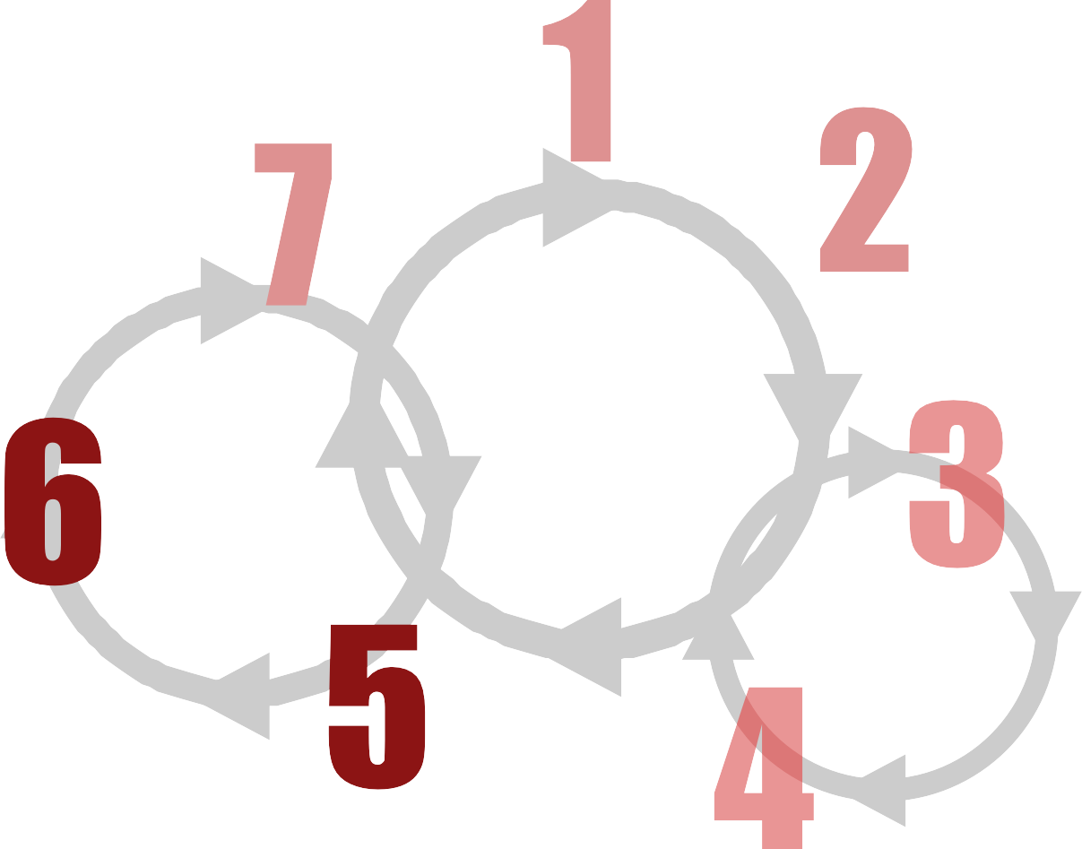
49
Design Sprint
Business, Requirement & Data Analysis
Evaluate & Experiment
Agile AI
Product
[Development]
Lifecycle
Release
AI Solution Research
Build
Rapid Experimentation

Slide 49










Focus Areas For AI Leaders
50
During Build and Release
People
Ensure interaction
Partnerships Keep the relationship strong
Solutions
Build the right thing
Environment Respect regulations and life
Practices
Build the thing right

Slide 50
Risk Management Framework
51
Identify
Assess
Control
Monitor
Stop
Strategic
Avoid
Track
Outsource
Operational
Accept
Contract
Predict
Self Insure
Compliance
Transfer
Alert
Insure
Train
Financial
Reduce
Communicate
Accept

Slide 51

Black Box AI Problems
52
Gender Bias
Race Bias
AMAZON
AMAZON
De-ranking LGBT books by mistakenly classifying them as "adult literature"
Prime same-day delivery service areas excluded ZIP codes by race to varying degrees
2016
2018
2009
2017
GOOGLE NEWS
Word embeddings trained on articles exhibit female/male gender stereotypes to a disturbing extent
GOOGLE TRANSLATE
Algorithm associates doctor with men and nurse with women in gender-neutral and gender-inclusive translations
Gender Bias
Gender Bias
The information on this slide is publicly available on the internet and aims to show how certain companies overcame issues related to AI

Slide 52
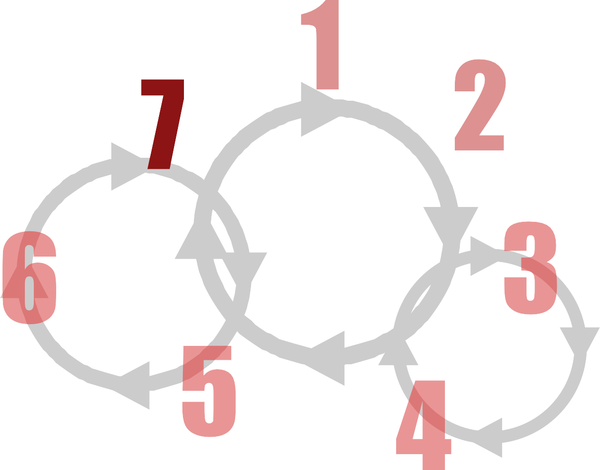
53
Design Sprint
Business, Requirement & Data Analysis
Evaluate & Experiment
Agile AI
Product
[Development]
Lifecycle
Release
AI Solution Research
Build
Rapid Experimentation

Slide 53

S.M.A.R.T criteria
54
Who will do it and can they do it?
MEASURABLE
ACHIEVABLE
Is it relevant to the goal?
TIME-BOUND
What is the target goal?
RELEVANT
SPECIFIC
How do you measure?
When is it needed?
S
M
A
R
T

Slide 54

KPI Lifecycle
55
Identify Metrics 1
4
Resolve Issues
2 Create Metrics
3
Monitor Metrics

Slide 55
Identify Metrics
56
1
KPIs; Metrics That Matter
- Business
Internal: to measure against corporate goals
Competitive: to measure against competitors
Market: to measure against market; industry limits, market trends, customers
- Product
Object: to measure the quality, performance, state of the product
Context: to measure the environment, temporal state
Activity: to measure the interaction of the subject with the product in a given context
Subject: to measure the customer/user archetype, state, quality
- Platform
Data: to measure data quality, integrity, performance, scalability, security, privacy
Model: to measure model integrity, performance, security, privacy
Hardware: to measure the hardware health, performance, scalability
Network: to measure the network health, performance, scalability, security

Slide 56





Experimentation Lifecycle
57
5) DECIDE
Analyze observed data and
make decision
1) HYPOTHESIS
State null and alternative hypotheses
Experimentation Lifecycle
4) COLLECT
Collect and monitor observation data
2) SETUP
Analyze experiment needs, setup experiment and test setup
3) RUN
Run the experiment

Slide 57
Experimentation Technique Trade-off
58
Constraint / Approach | Time | # of variants | Traffic
A/B
Multi-armed Bandit
Sequential
Multivariate

Slide 58
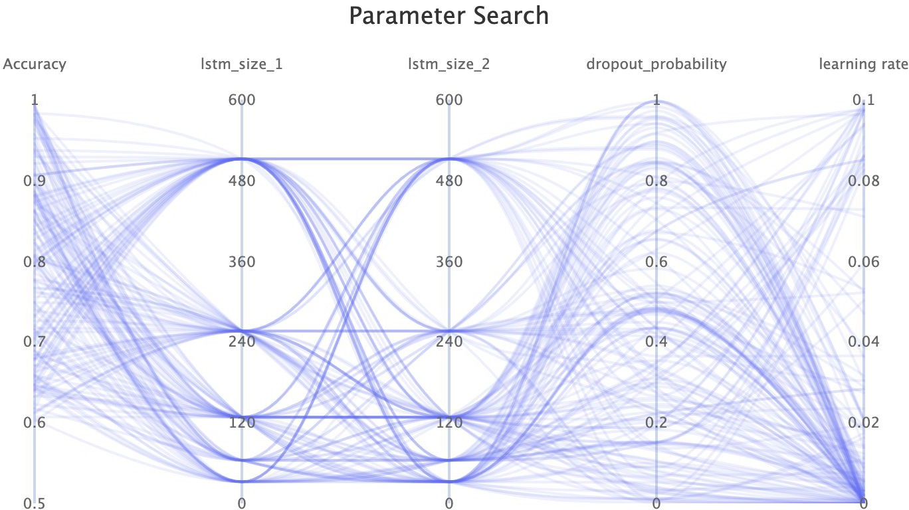
ML Experiment Management Tools
47
Advantages
End-to-end management
Collaboration
Tracking experiments
Organizing projects
Compare metrics
Products
Azure ML Studio
comet.ml
MLFlow
Studio.ml
neptune.ml
...
Comet.ml Hyperparameter Optimization interactive visualization

